Slide 1
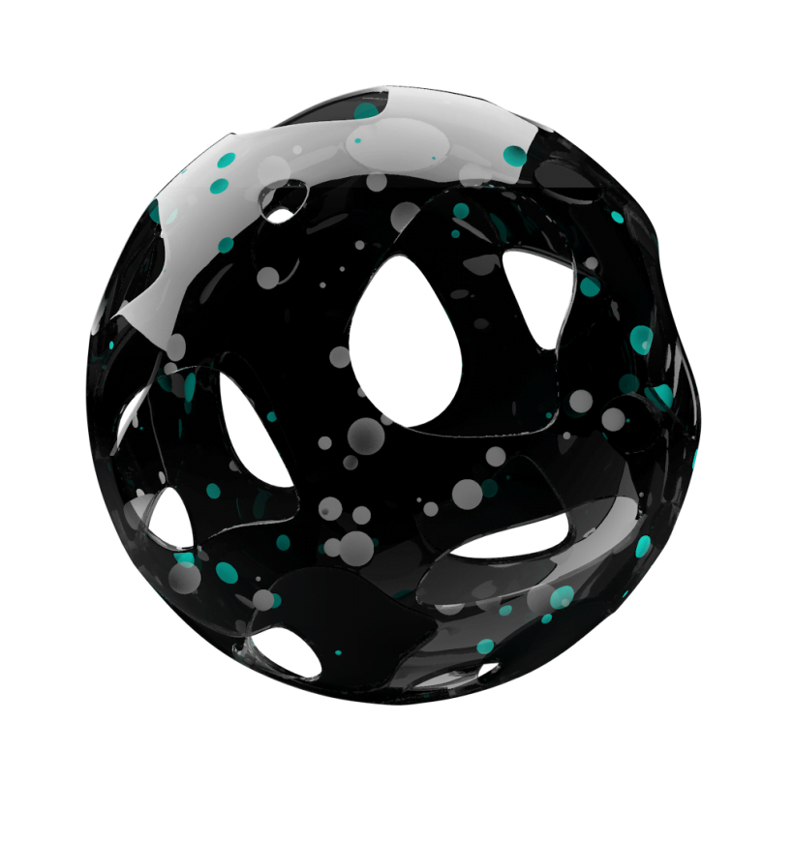
Privacy
And
Voice Screening
For Environmental Sound Identification
Notes:
Imagine you’re on holiday with your partner or your family. You have your own private corner of bush, no one else around. You relax, explore, spend time together. Then, one month later, you find out that your conversations were recorded and someone in an office three hours away has listened to them. How would you feel?

Slide 2
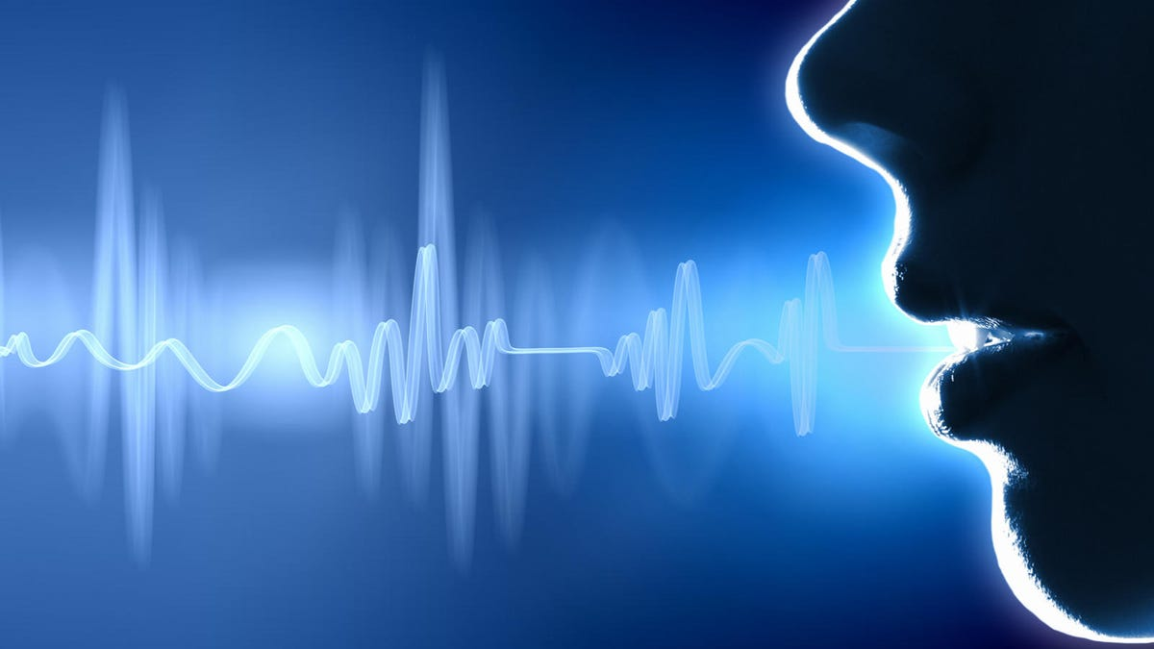

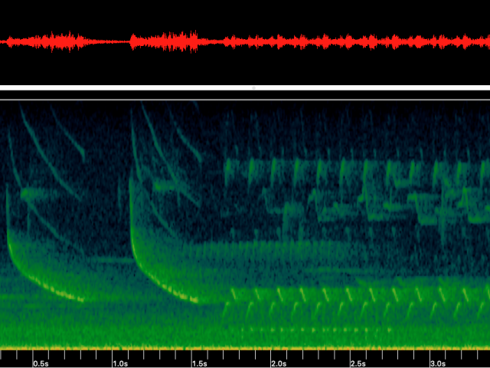
The Privacy Problem
How would you feel
if a private conversation was recorded
without your consent?
Notes:
I think most people would be uncomfortable with this. Their privacy was violated.
Why would this happen?

Slide 3

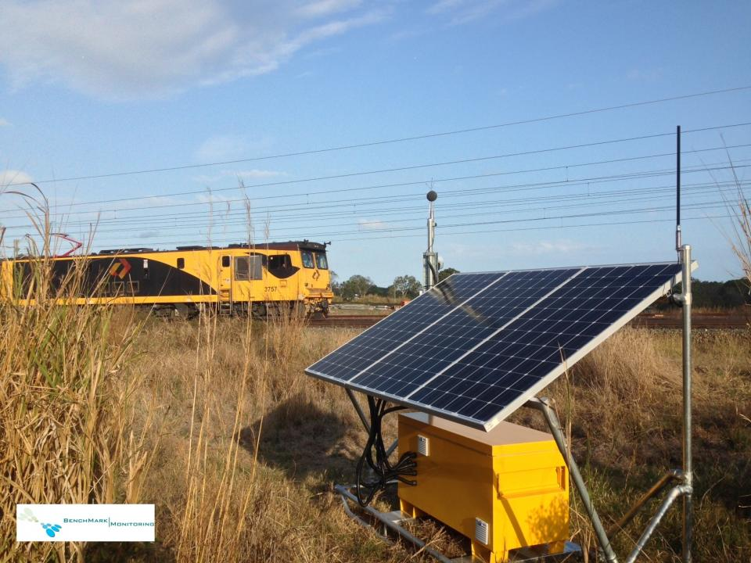
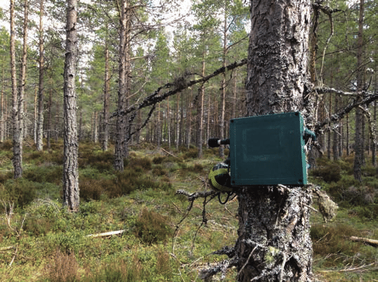
The Contexts : Environmental Sound Identification
For Industrial Noise Management
For Environmental Management
Notes:
Environmental sound identification - using AI/Machine learning to classify audio
Industrial applications: measure noise pollution, track vehicle movement Environmental applications - survey bird/insect/frog populations, track human or animal movements
Requires high quality sound data – hence voice and conversations are recorded

Slide 4
What is the Current Solution?
NOTHING!
Notes:
What is currently being done to protect the privacy of people near the monitors?
*shrug*
So we came up with a solution

Slide 5




The Solution - Pre-Screening
Preprocessing
ML Model – Voice Yes / No
Does this contain voice data?
Raw Audio Data
Yes
No
Discard data
Continue routine assessment
Notes:
Develop a simple ML model that can identify whether or not audio data contains a voice – by keeping the model goals small, time, computation, and power consumption is minimal
Install on the device in the field and apply immediately after recording
If voice is identified, exclude the data from further analysis and mark it as voice (for traceability)
The monitor functions as normal, but voice data is excluded at the earliest possible point in the process (and is never stored) – minimising privacy impacts

Slide 6



The Solution Details
Once sufficient data is cached (~5s), apply speech recognition model
Cache of input data
Input data 1/3 octave, short time step (<1 s, often 125 ms)
Speech recognised
No speech recognised
Cache data waiting for voice screening
Set data in cache to 0
(do not delete entry, just clear values)
Core data analysis/ML classification
Release cached data
Notes:
The monitor initially collects the audio data in high detail
Recognising voice takes at least a few seconds of input – so store the data in a temporary cache until there is enough
Run the voice identification algorithm over the data in the cache – it returns a YES (there is voice) or NO (no voice)
If YES – set the cached data to 0 – this makes it clear that voice data has been filtered out
Send the cache into the rest of the analysis process

Slide 7
Stakeholders
 | Low interest | High interest
Low power | Monitor Audio monitoring customers Data customers | Keep informed Public users
High power | Keep satisfied Government | Manage closely Audio monitoring manufacturers/operators Audio ML developers
Notes:
[discuss the stakeholders]

Slide 8
What We Bring to Target Customers
Protection
from legal concerns
Responsible practice
Less data to store
Notes:
Customers are important! Our project should benefit them and they should want to use it even if there’s no law requiring them to
For manufacturers and operators of noise logging systems, our solution provides multiple benefits all with minimal impact to current operation
-Responsible practice – promote to your customers and to the general public
-Less data to store
-Protection from legal concerns

Slide 9
A Viable and Responsible Solution
For customers
For the public
Minimal power usage
Minimal computation required
Traceability
No marginalised voice types
Balance between privacy and surveillance benefits

Slide 10

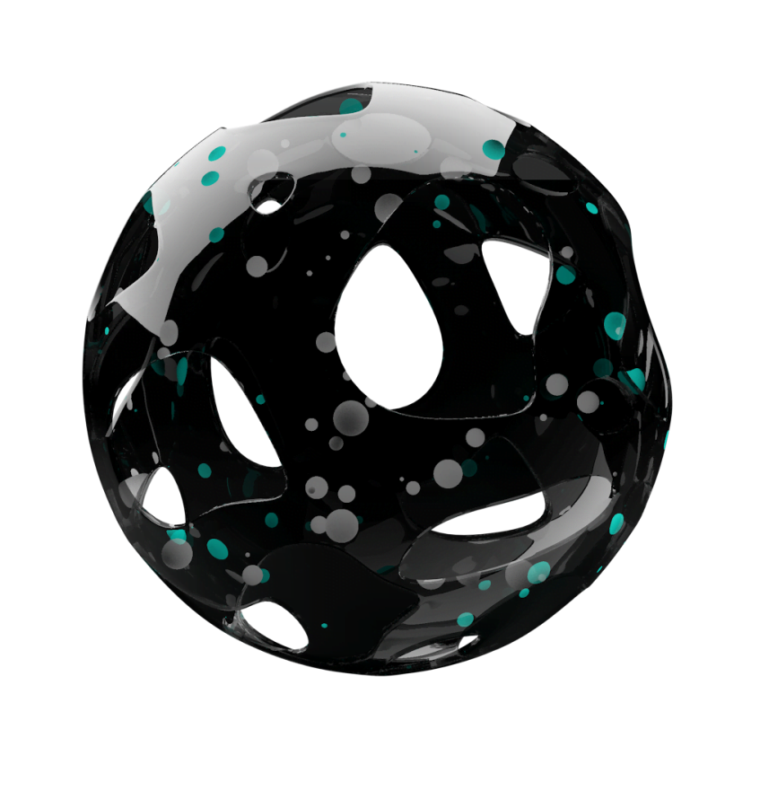
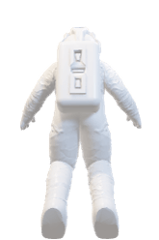
THA
NKS

